Slide 1

Introducing {workboots}
Generate prediction intervals from tidymodel workflows
Mark Rieke
@markjrieke
2022-07-27
Notes:
Hi everyone! Thank you for coming to my talk. My name is Mark Rieke and today I’ll be introducing workboots, which is a package for generating prediction intervals from a tidymodel workflow.
Before we get into that, I want to talk about tools!
I do a lot of home improvement projects, so I’ve seen a wide variety of *interesting* tools

Slide 2
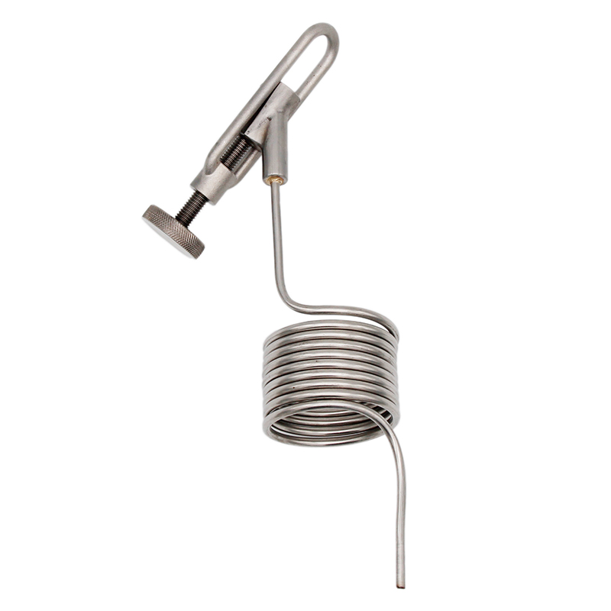
Notes:
Pigtail proof coil
Lets brewers take samples from big beer tanks

Slide 3
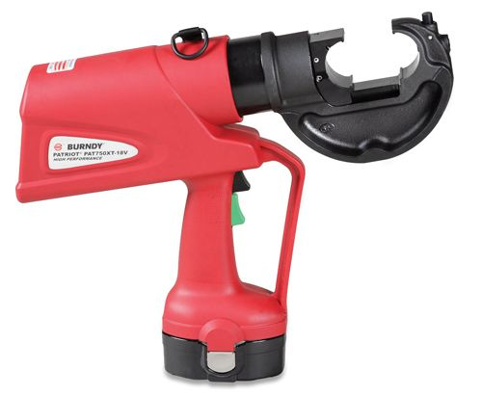
Notes:
Wire crimper
Useful for dealing with large electrical lugs

Slide 4
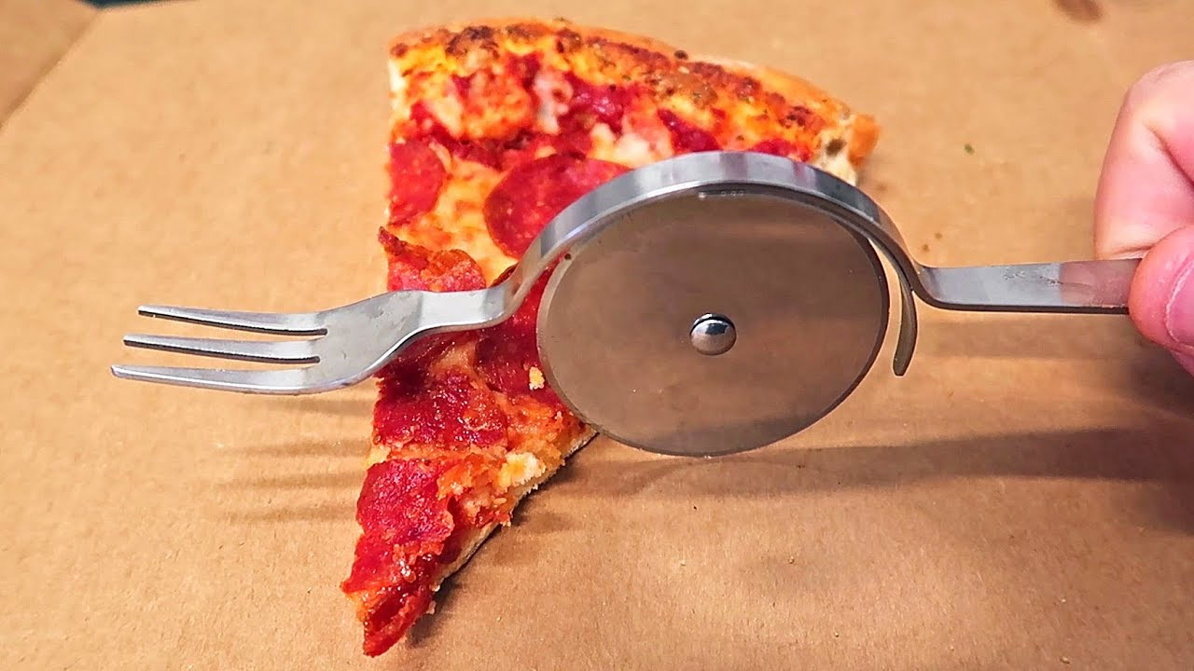

Slide 5
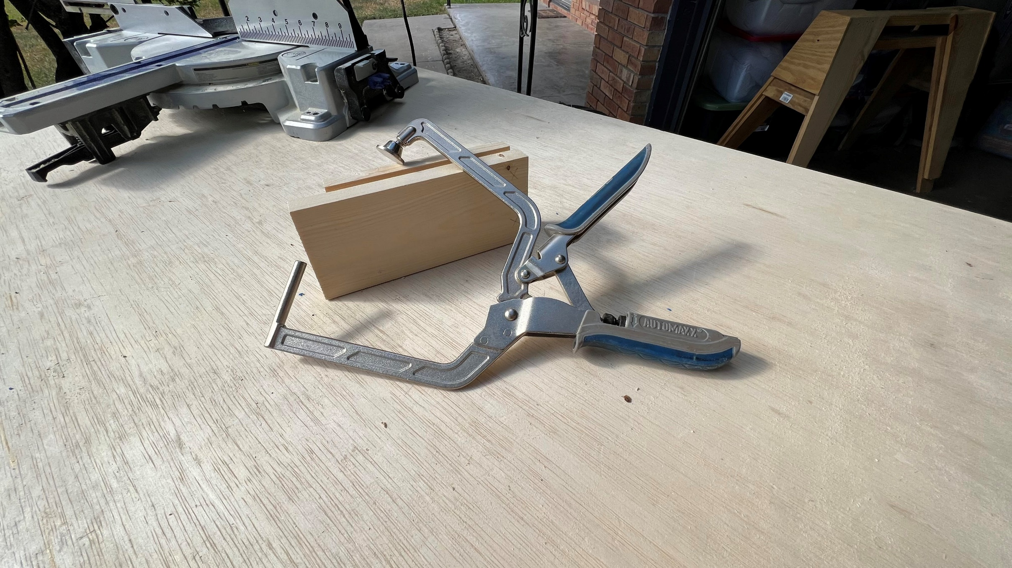

Slide 6
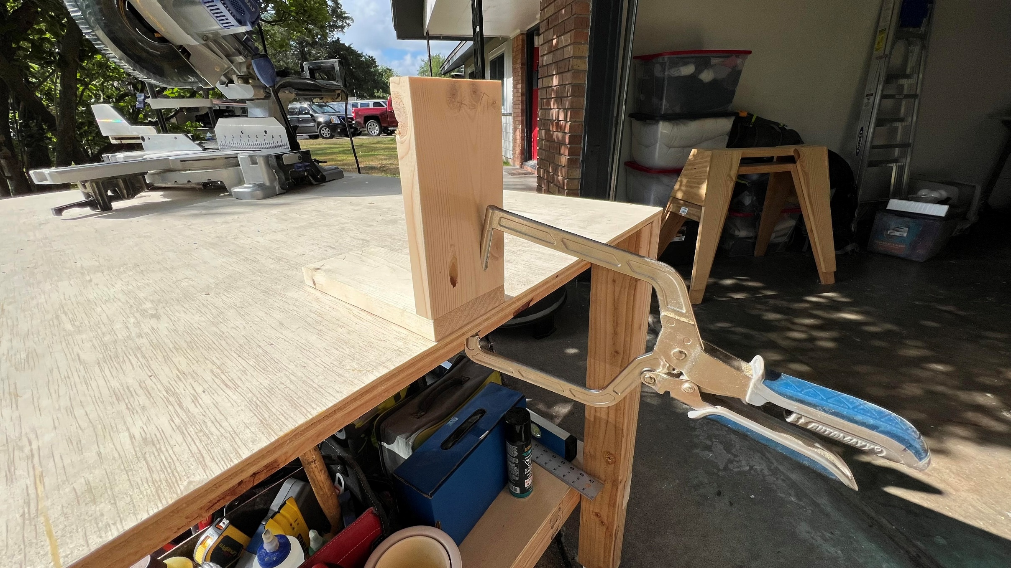
Notes:
“Right tool for the right job”

Slide 7
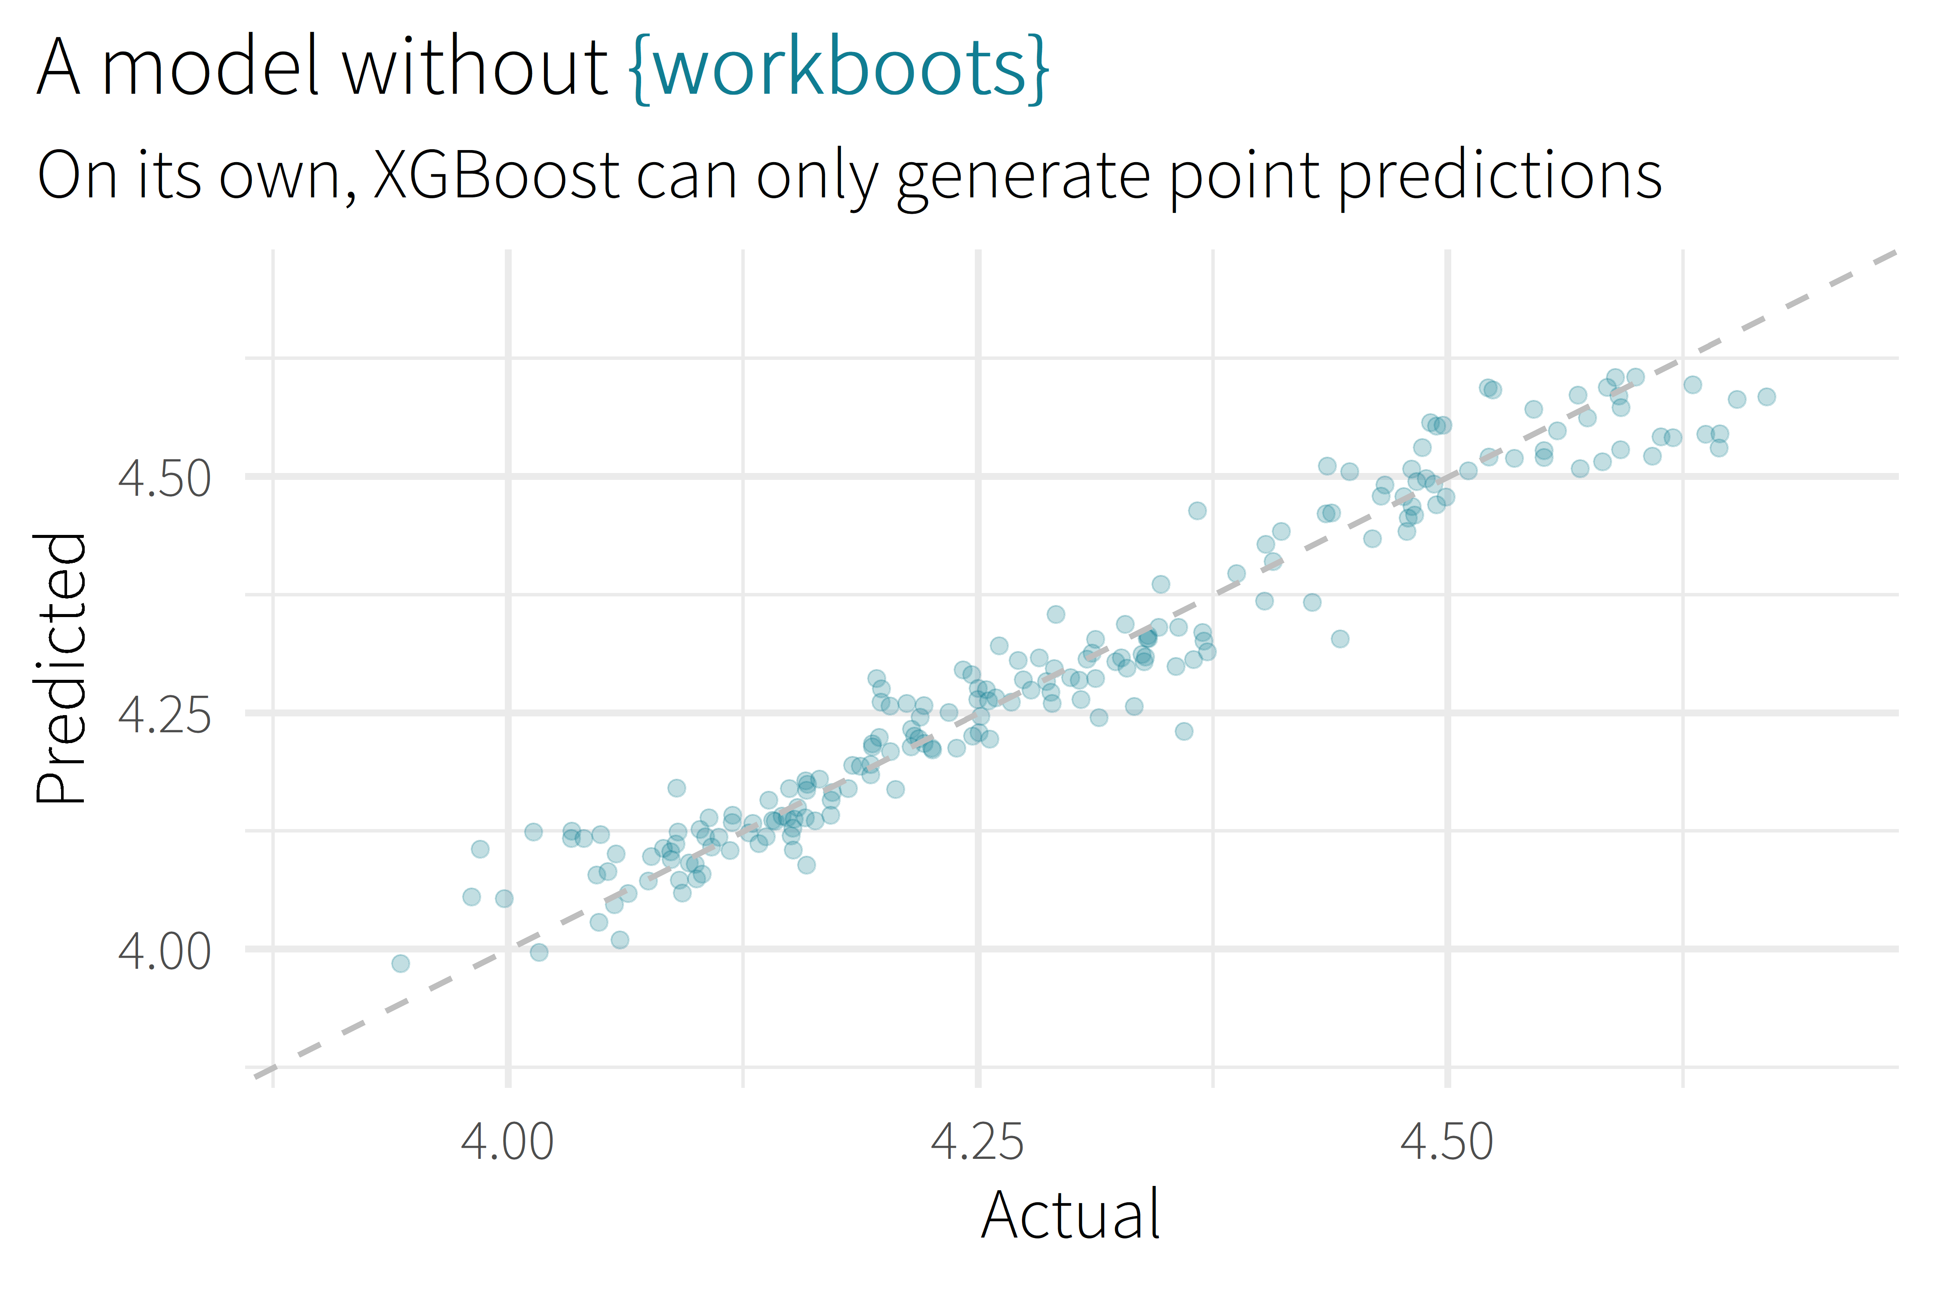

Slide 8
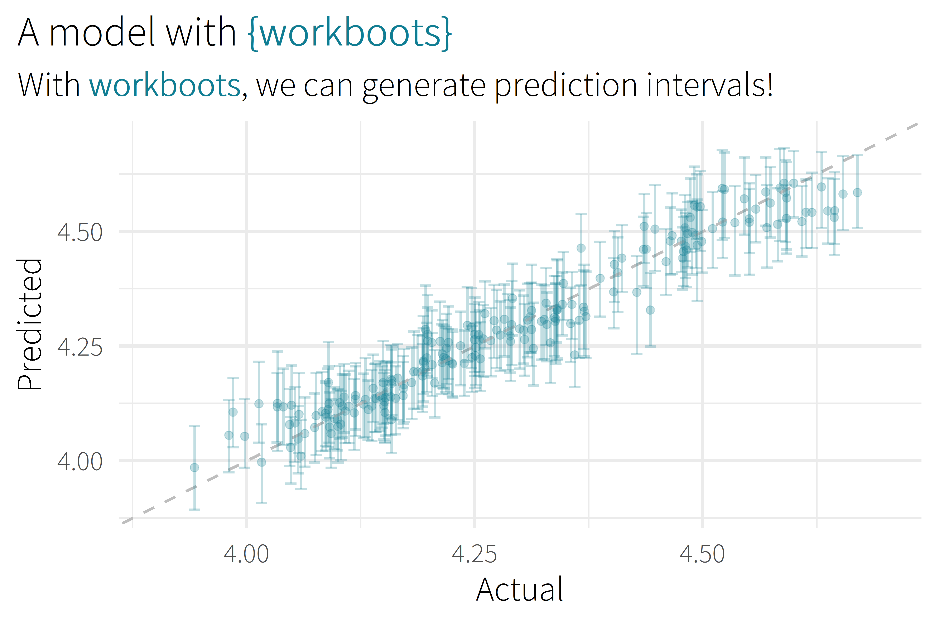

Slide 9

Motivation/Background

Slide 10

about me
Sr. CX Analyst, MHHS
Patient satisfaction survey data
Administer, understand, improve
Answering questions
Notes:
Senior consumer experience analyst for Memorial Hermann Health System
Large hospital system in Houston
17 hospitals (11 acute-care)
Hundreds of clinics
Around 30,000 employees
Small but mighty team of 4 – thankful that they’re holding down the fort
Work with patient satisfaction surveys

Slide 11
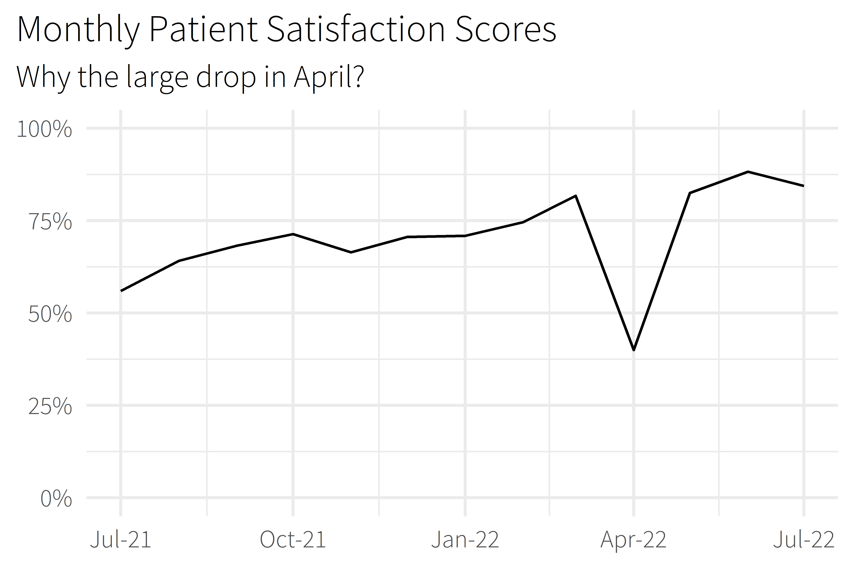

Slide 12
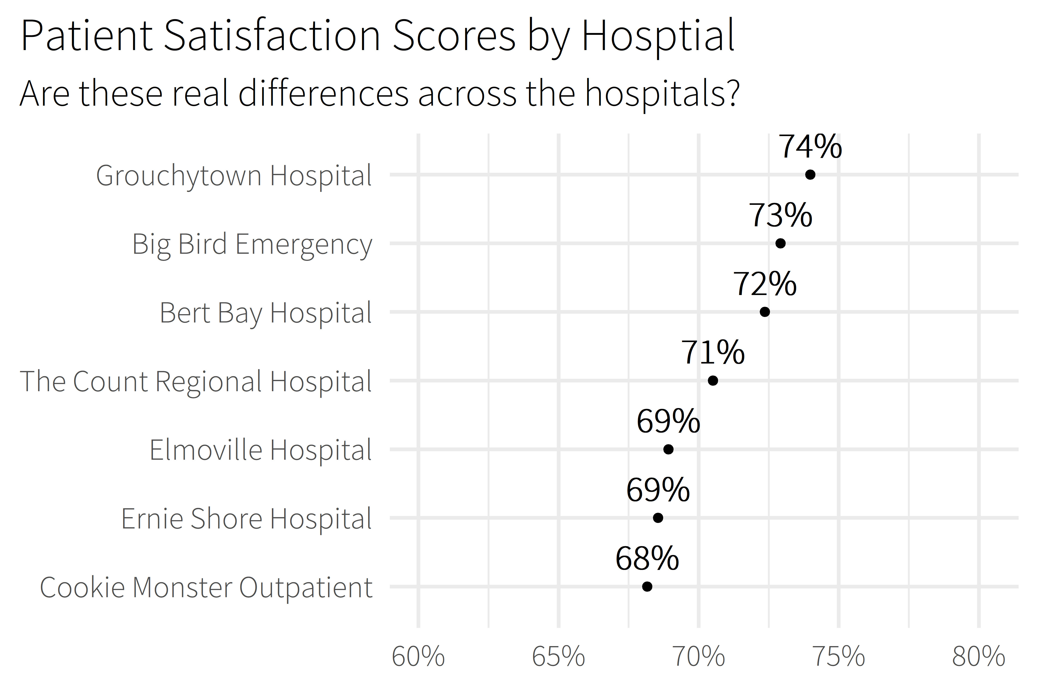

Slide 13
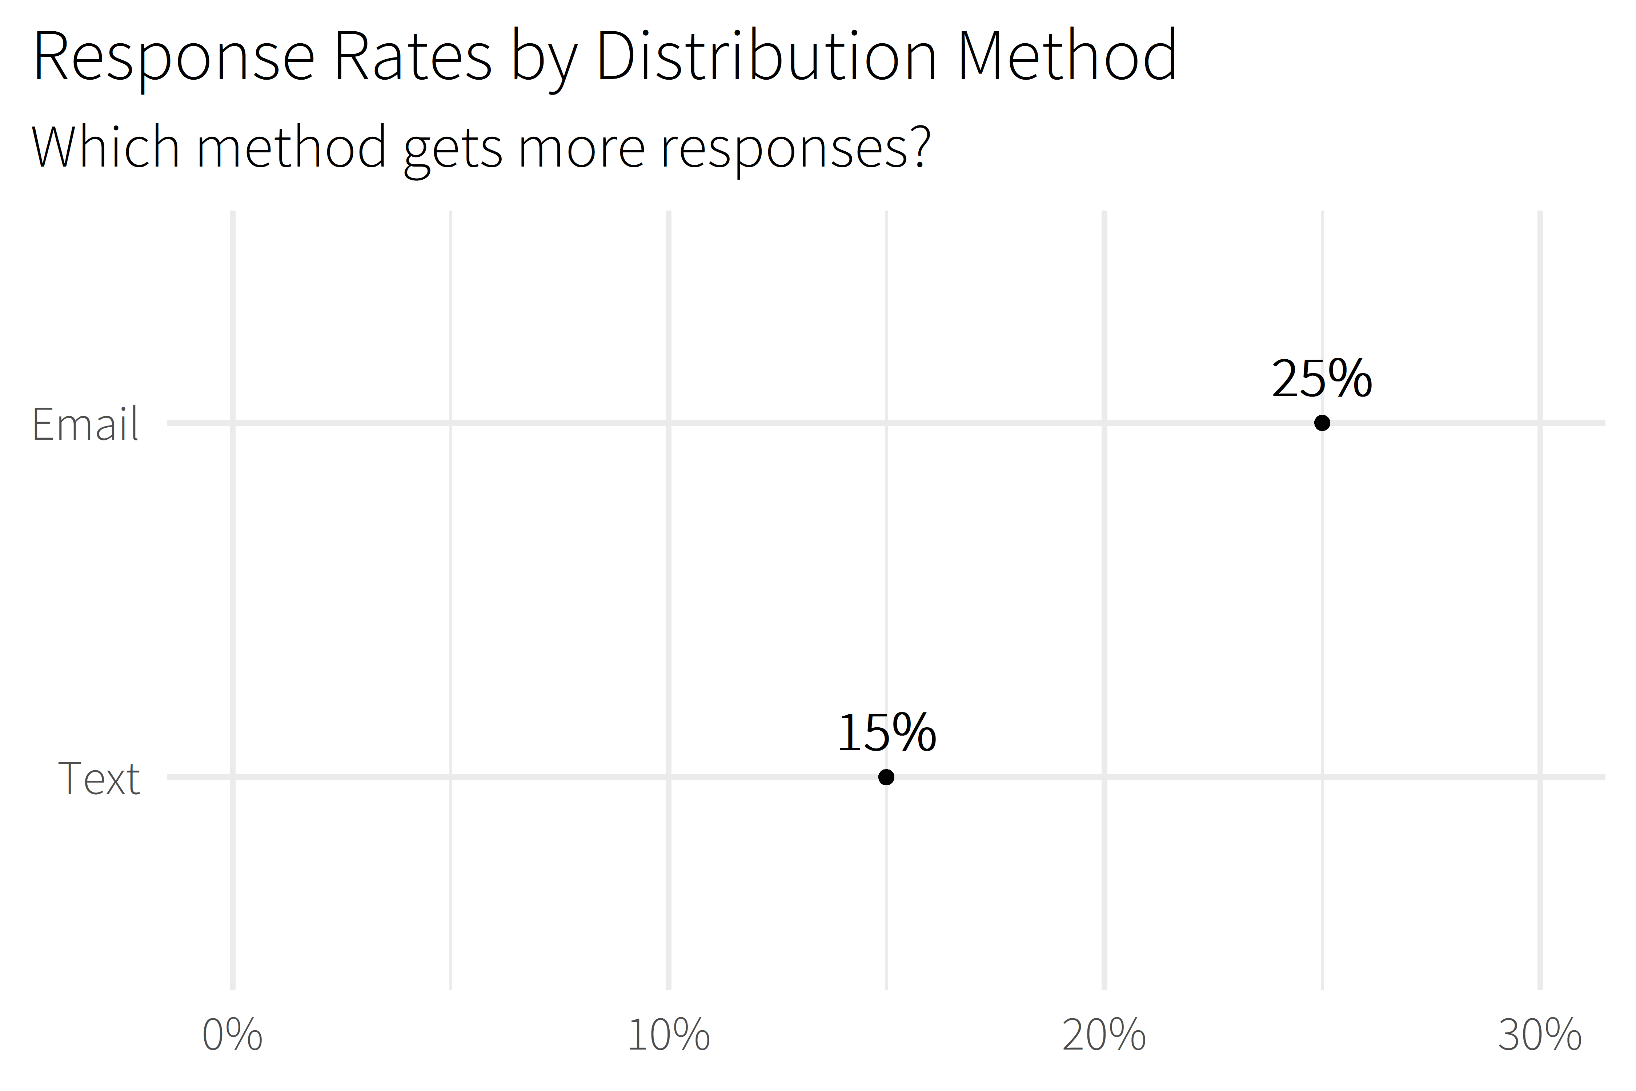

Slide 14
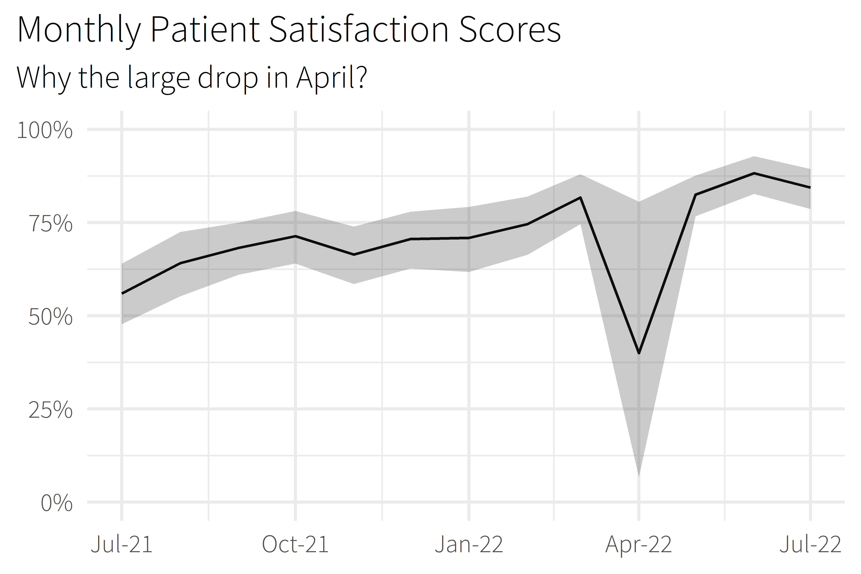

Slide 15
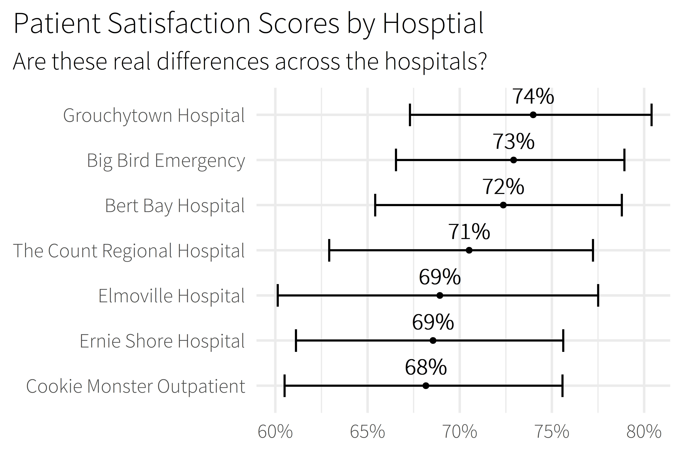

Slide 16
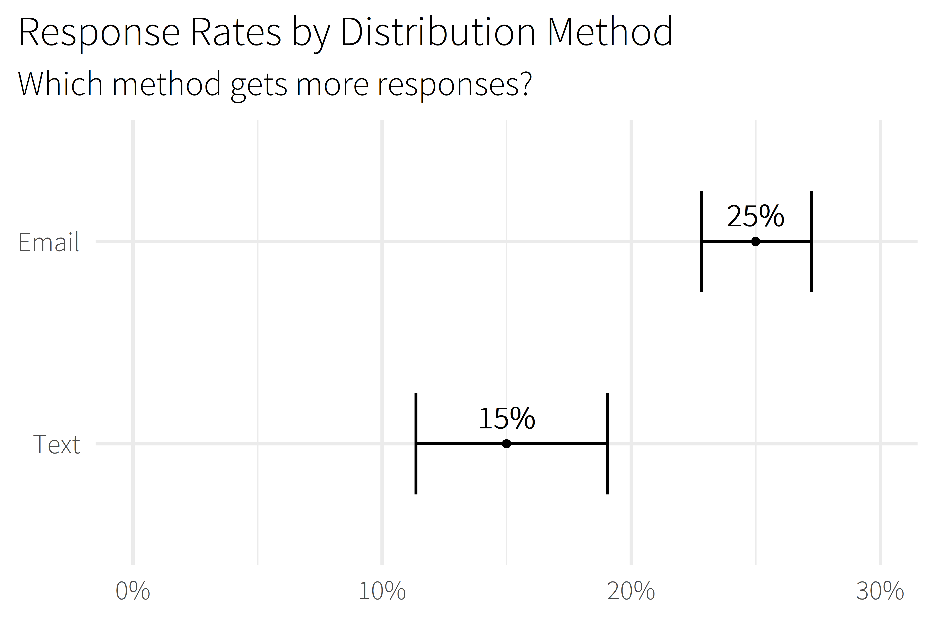

Slide 17

5.0 (19)
4.6 (2,280)

Slide 18
What are the drivers of patient satisfaction?
What will our score be?
How many responses are we expecting?
Notes:
Senior consumer experience analyst for Memorial Hermann Health System
Large hospital system in Houston
17 hospitals (11 acute-care)
Hundreds of clinics
Around 30,000 employees
Small but mighty team of 4 – thankful that they’re holding down the fort
Work with patient satisfaction surveys

Slide 19

lm()
me
XGBoost

Slide 20
Prediction Intervals
{workboots}
Powerful Models
via bootstrap resampling

Slide 21
Package Overview

Slide 22
model building timeline
Exploratory Data Analysis
Model Fit
Model Evaluation
Feature Engineering
Model Finalization
Model Tuning
Notes:
Slide I totally stole from Julia Silge!

Slide 23
model building timeline
workboots
tidymodels
Exploratory Data Analysis
Model Fit
Model Evaluation
Feature Engineering
Model Finalization
Model Tuning
Notes:
Slide I totally stole from Julia Silge!

Slide 24
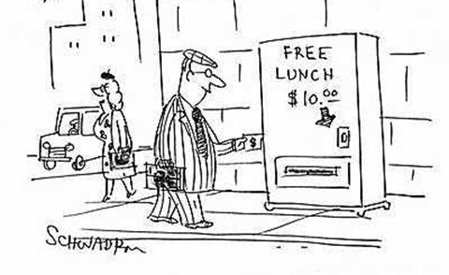
workboots checklist
Normally distributed residuals
Time to run
Actually need powerful model

Slide 25

how this works
Generate resamples
Fit many models to resamples
Predict on new data
Summarize prediction range
Notes:
Bootstrap resamples

Slide 26
using workboots
Set up a workflow
Generate predictions
Summarise results

Slide 27

set up a workflow
library(tidymodels)

Slide 28
set up a workflow
library(tidymodels)
# setup our data
data(“penguins”)
penguins <- penguins %>% drop_na()

Slide 29
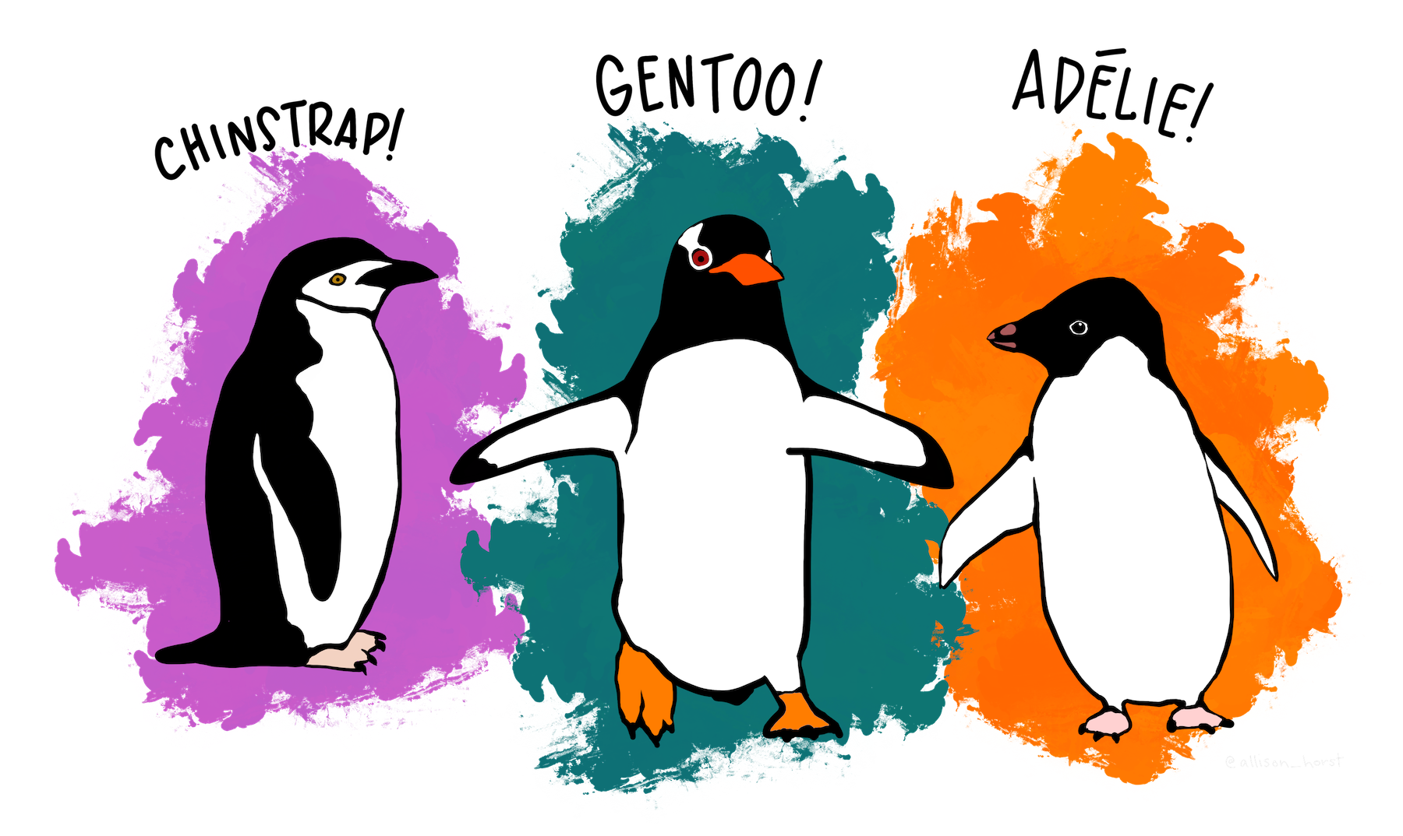
set up a workflow
penguins %>% glimpse()
#> Rows: 333
#> Columns: 7
#> $ species <fct> Adelie, Adelie, Adelie, ...
#> $ island <fct> Torgersen, Torgersen, To...
#> $ bill_length_mm <dbl> 39.1, 39.5, 40.3, 36.7, ...
#> $ bill_depth_mm <dbl> 18.7, 17.4, 18.0, 19.3, ...
#> $ flipper_length_mm <int> 181, 186, 195, 193, 190,...
#> $ body_mass_g <int> 3750, 3800, 3250, 3625, ...
#> $ sex <fct> male, female, female, fe...

Slide 30
set up a workflow
library(tidymodels)
# setup our data
data(“penguins”)
penguins <- penguins %>% drop_na()
set.seed(123)
penguins_split <- initial_split(penguins)
penguins_test <- testing(penguins_split)
penguins_train <- training(penguins_split)

Slide 31
set up a workflow
# setup a basic preprocessing recipe
penguins_rec <-
recipe(body_mass_g ~ ., data = penguins_train) %>%
step_dummy(all_nominal())

Slide 32
set up a workflow
# setup a basic preprocessing recipe
penguins_rec <-
recipe(body_mass_g ~ ., data = penguins_train) %>%
step_dummy(all_nominal())

Slide 33
set up a workflow
# setup a basic preprocessing recipe
penguins_rec <-
recipe(body_mass_g ~ ., data = penguins_train) %>%
step_dummy(all_nominal())
# put together a workflow
penguins_wf <-
workflow() %>%
add_recipe(penguins_rec) %>%
add_model(boost_tree(“regression”))
Notes:
Notes
All tuning parameters finalized (in this case, we’re just using the defaults)
Workflow hasn’t been fit

Slide 34
set up a workflow
# setup a basic preprocessing recipe
penguins_rec <-
recipe(body_mass_g ~ ., data = penguins_train) %>%
step_dummy(all_nominal())
# put together a workflow
penguins_wf <-
workflow() %>%
add_recipe(penguins_rec) %>%
add_model(boost_tree(“regression”))
Notes:
Notes
All tuning parameters finalized (in this case, we’re just using the defaults)
Workflow hasn’t been fit

Slide 35
time for workboots!
Notes:
Senior consumer experience analyst for Memorial Hermann Health System
Large hospital system in Houston
17 hospitals (11 acute-care)
Hundreds of clinics
Around 30,000 employees
Small but mighty team of 4 – thankful that they’re holding down the fort
Work with patient satisfaction surveys

Slide 36

generate predictions
library(workboots)

Slide 37
generate predictions
library(workboots)
# generate a bootstrap prediction interval
set.seed(345)
penguins_preds <-
penguins_wf %>%
predict_boots(
n = 2000,
training_data = penguins_train,
new_data = penguins_test,
interval = “prediction”
)

Slide 38
generate predictions
library(workboots)
# generate a bootstrap prediction interval
set.seed(345)
penguins_preds <-
penguins_wf %>%
predict_boots(
n = 2000,
training_data = penguins_train,
new_data = penguins_test,
interval = “prediction”
)
Notes:
Number of bootstrap predictions to make

Slide 39
generate predictions
library(workboots)
# generate a bootstrap prediction interval
set.seed(345)
penguins_preds <-
penguins_wf %>%
predict_boots(
n = 2000,
training_data = penguins_train,
new_data = penguins_test,
interval = “prediction”
)
Notes:
Supply both our training data and new data in one step, since we’ll be fitting and predicting with one function call

Slide 40
generate predictions
library(workboots)
# generate a bootstrap prediction interval
set.seed(345)
penguins_preds <-
penguins_wf %>%
predict_boots(
n = 2000,
training_data = penguins_train,
new_data = penguins_test,
interval = “prediction”
)
Notes:
Supply both our training data and new data in one step, since we’ll be fitting and predicting with one function call

Slide 41
generate predictions
penguins_preds
#> # A tibble: 84 x 5
#> rowid .preds
#> <int> <list>
#> 1 1 <tibble [2,000 x 2]>
#> 2 2 <tibble [2,000 x 2]>
#> 3 3 <tibble [2,000 x 2]>
#> 4 4 <tibble [2,000 x 2]>
#> 5 5 <tibble [2,000 x 2]>
#> # ... With 79 more rows
Notes:
Returns a tibble with 2000 nested predictions for each observation. In this case, each row represents a penguin in the penguins_test dataset.

Slide 42
summarise results
penguins_preds %>%
summarise_predictions() %>% select(-.preds)
#> # A tibble: 84 x 5
#> rowid .pred .pred_lower .pred_upper
#> <int> <dbl> <dbl> <dbl>
#> 1 1 3465. 2913. 3994.
#> 2 2 3535. 2982. 4100.
#> 3 3 3604. 3050. 4187.
#> 4 4 4157. 3477. 4764.
#> 5 5 3868. 3305. 4372.
#> # ... With 79 more rows
Notes:
Returns a tibble with 2000 nested predictions for each observation. In this case, each row represents a penguin in the penguins_test dataset.

Slide 43
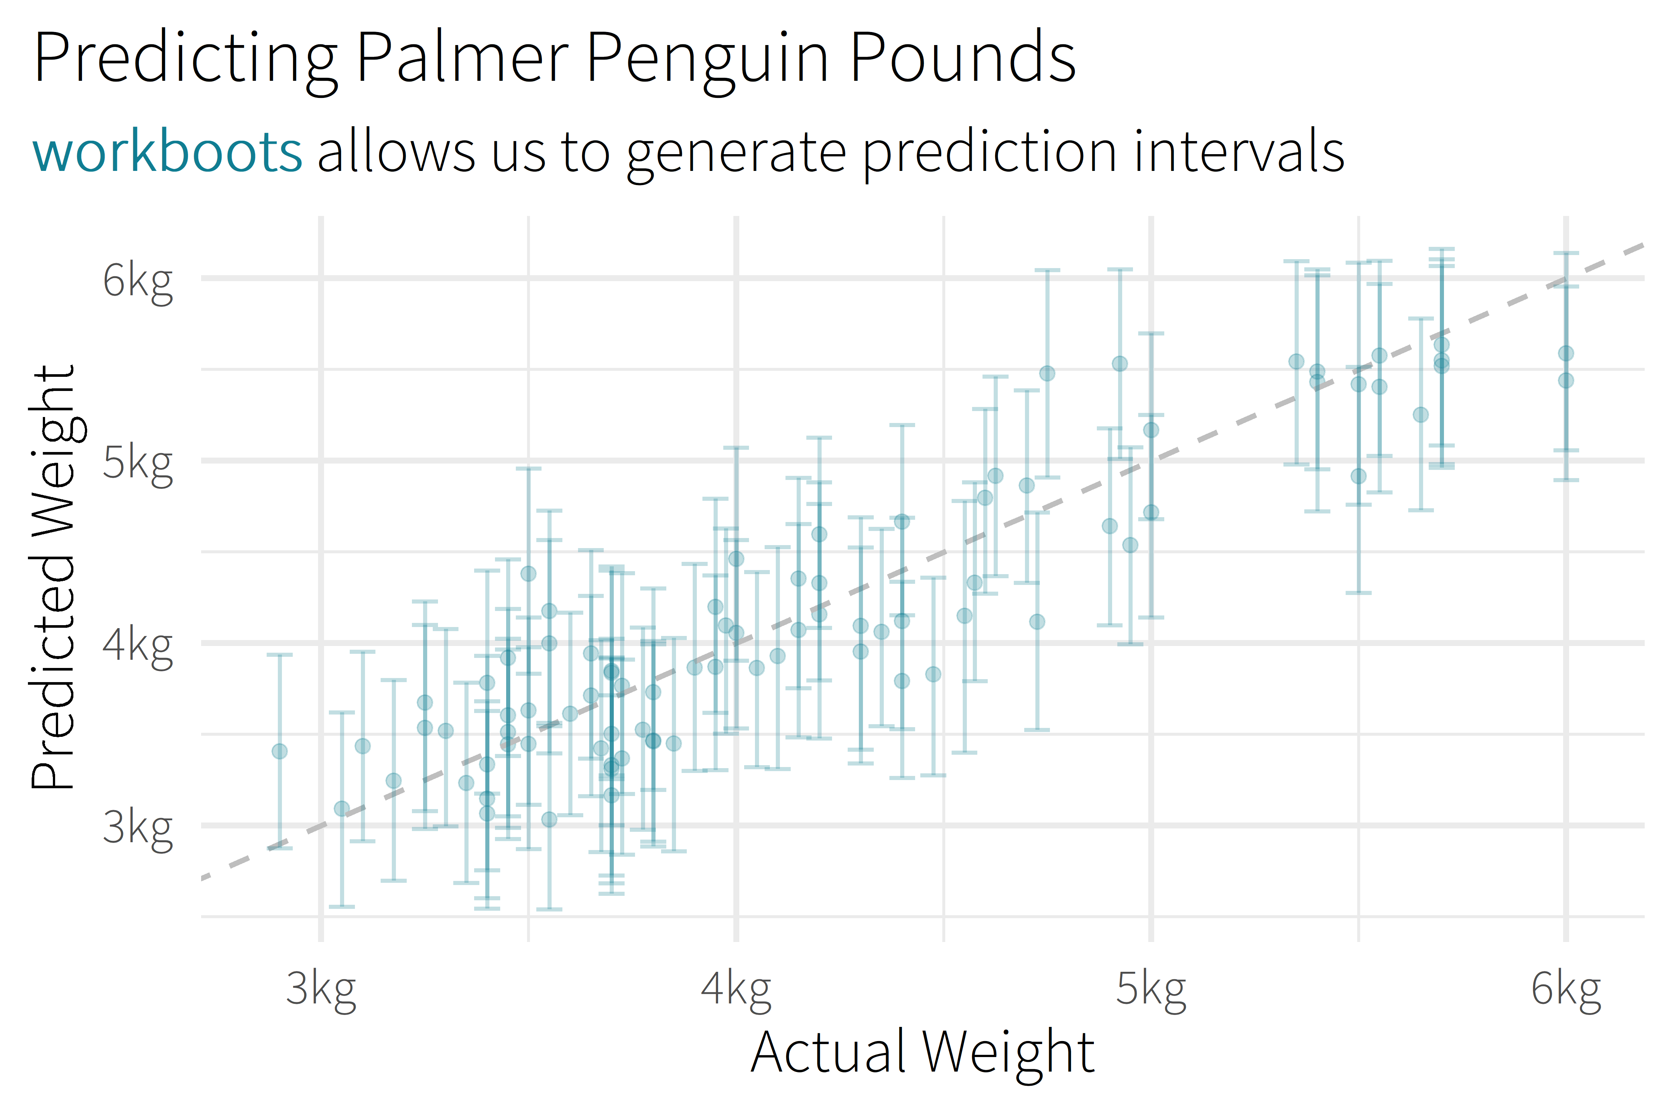
Notes:
Talk about features themselves – e.g., according to this model, flipper length is really important, but which island the penguin comes from isn’t.

Slide 44
generate predictions
library(workboots)
# generate a bootstrap prediction interval
set.seed(345)
penguins_preds <-
penguins_wf %>%
predict_boots(
n = 2000,
training_data = penguins_train,
new_data = penguins_test,
interval = “prediction”
)

Slide 45
generate predictions
library(workboots)
# generate a bootstrap prediction interval
set.seed(345)
penguins_preds <-
penguins_wf %>%
predict_boots(
n = 2000,
training_data = penguins_train,
new_data = penguins_test,
interval = “prediction”
)
Notes:
By default, predict_boots() will generate a prediction interval

Slide 46
generate predictions
library(workboots)
# generate a bootstrap prediction interval
set.seed(345)
penguins_preds <-
penguins_wf %>%
predict_boots(
n = 2000,
training_data = penguins_train,
new_data = penguins_test,
interval = “confidence”
)
Notes:
But we can also generate

Slide 47
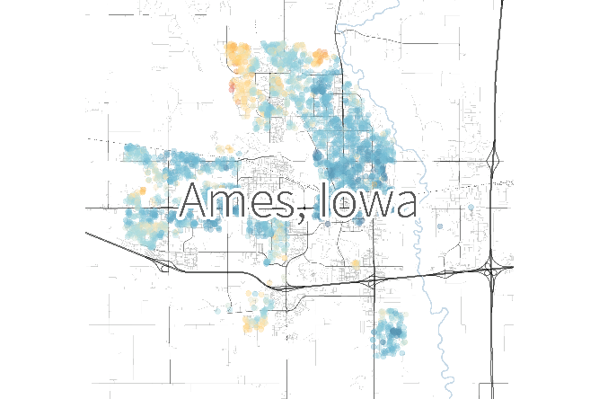
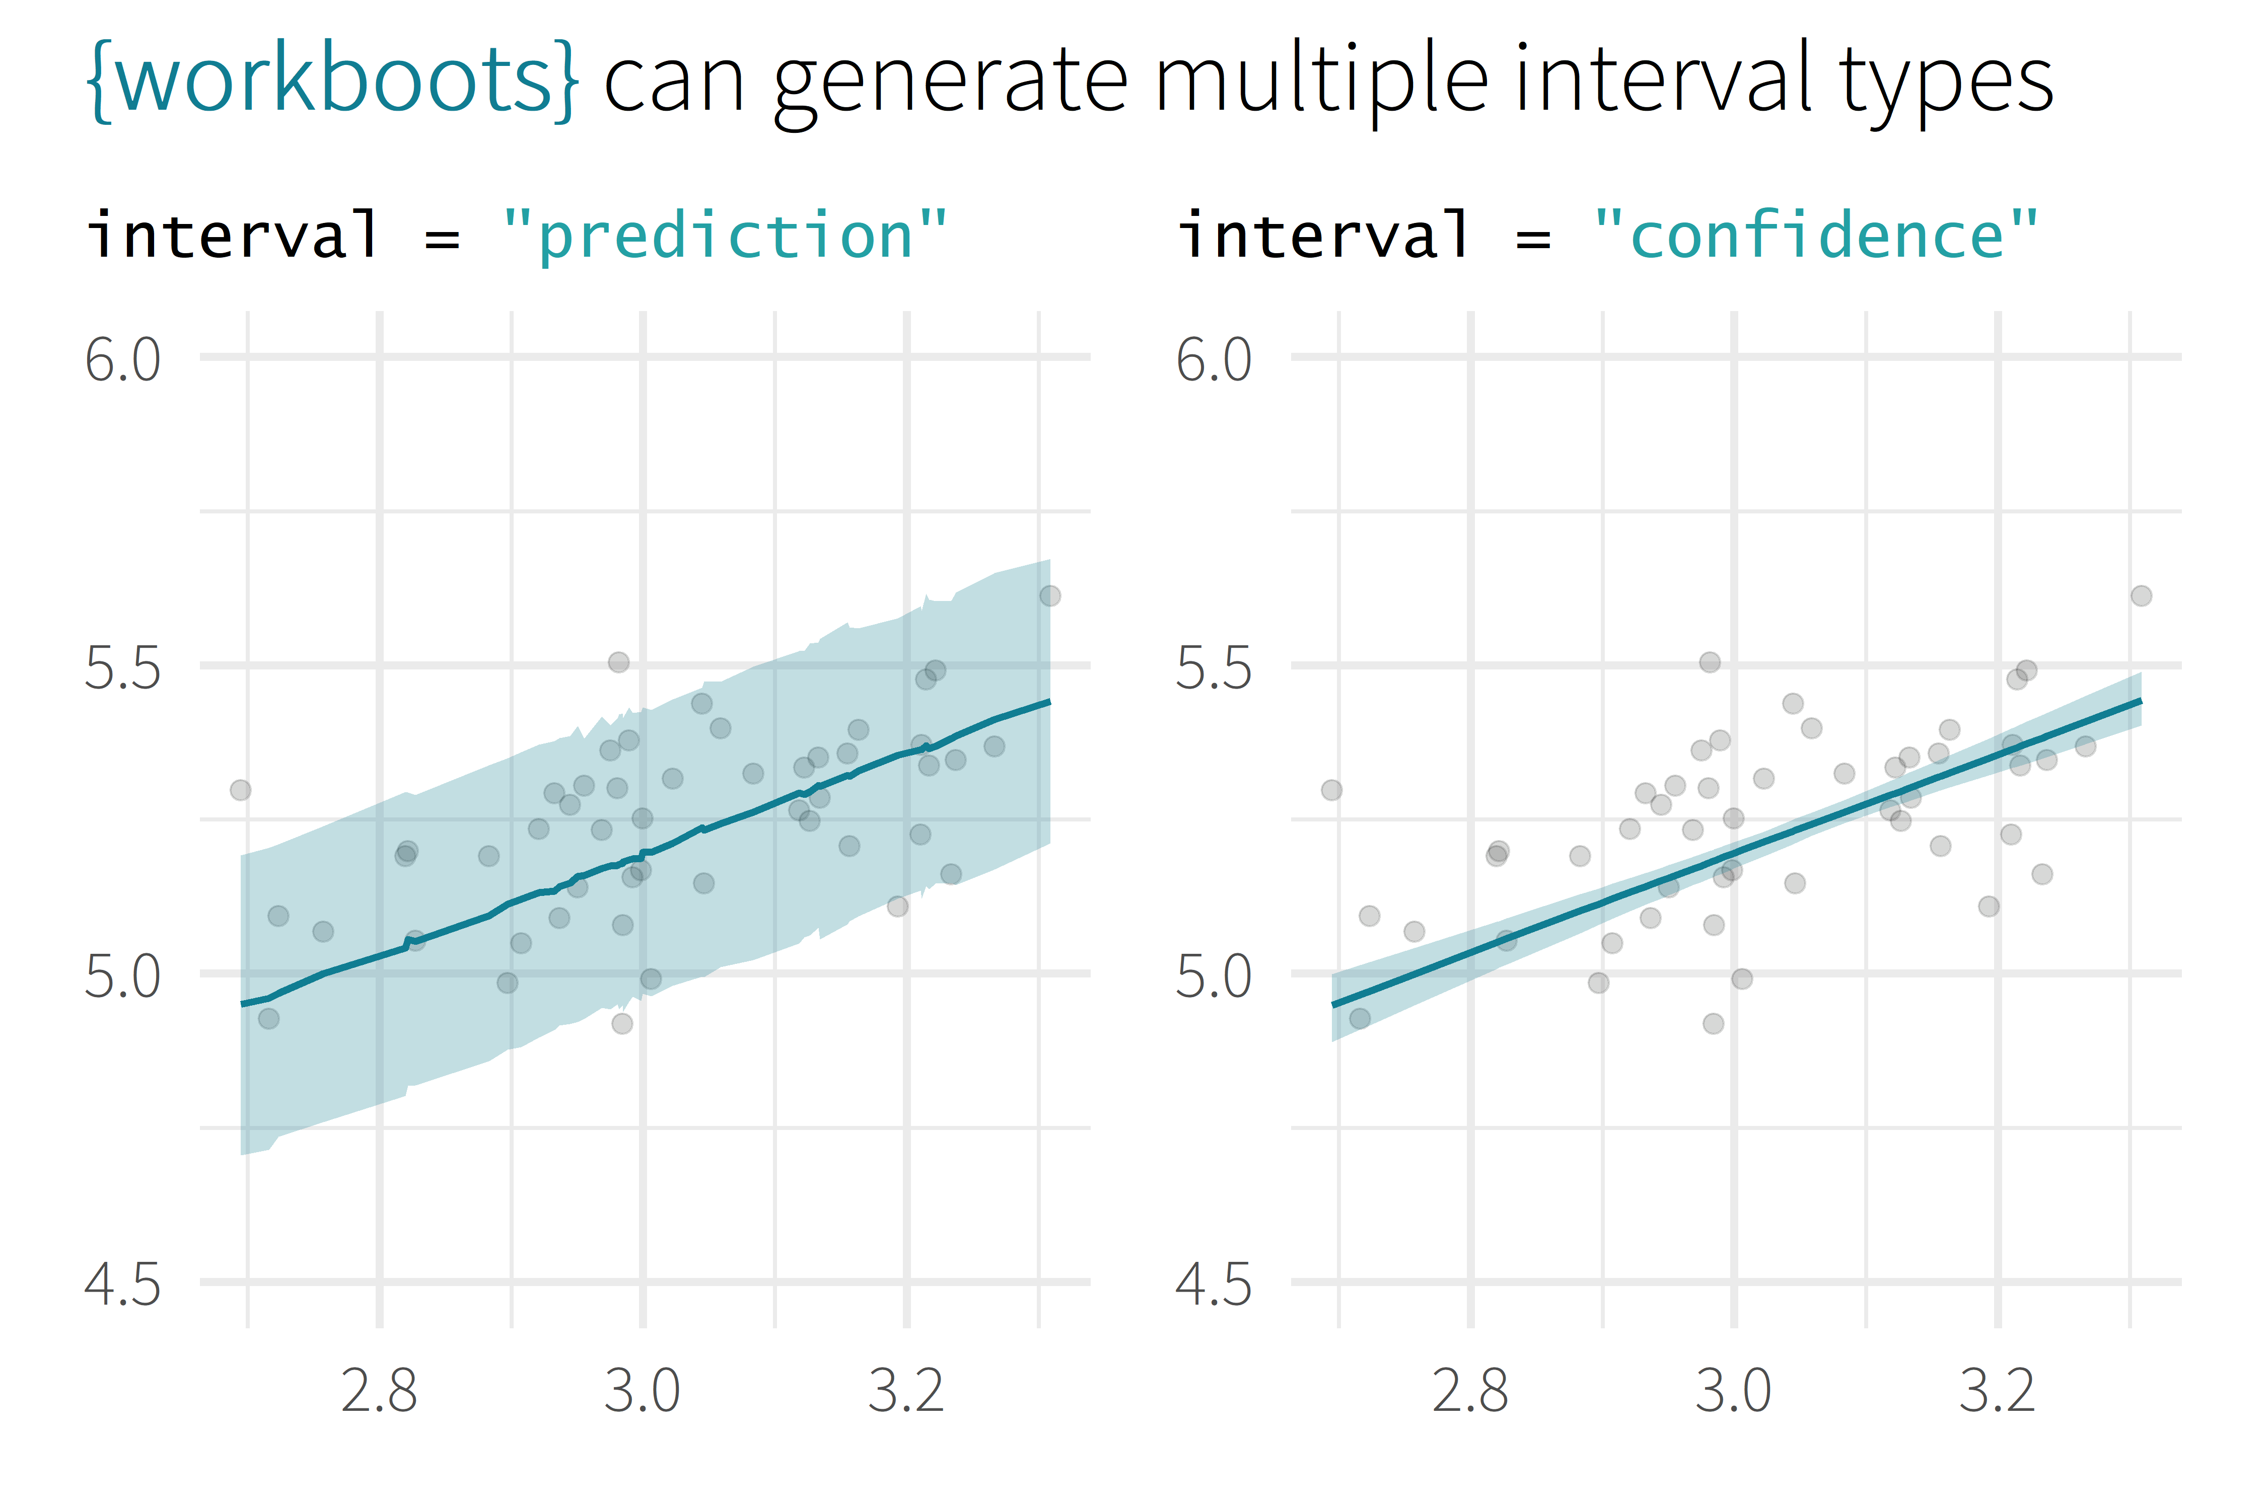
log10(Sale_Price)
log10(First_Flr_SF)

Slide 48
generate importances
# generate a bootstrap variable importances
set.seed(345)
penguins_vi <-
penguins_wf %>%
vi_boots(
n = 2000,
training_data = penguins_train
)

Slide 49
generate importances
penguins_vi
#> # A tibble: 8 x 2
#> variable .importances
#> <int> <list>
#> 1 flipper_length_mm <vi [2,000 x 2]>
#> 2 species_Gentoo <vi [1,928 x 2]>
#> 3 bill_length_mm <vi [2,000 x 2]>
#> 4 bill_depth_mm <vi [2,000 x 2]>
#> 5 sex_male <vi [2,000 x 2]>
#> # ... With 3 more rows

Slide 50
summarise importances
penguins_vi %>%
summarise_importance() %>% select(-.importances)
#> # A tibble: 8 x 2
#> variable .importance .importance_lower
#> <int> <dbl> <dbl>
#> 1 flipper_length_mm 0.464 0.254
#> 2 species_Gentoo 0.402 0.044
#> 3 bill_length_mm 0.045 0.027
#> 4 bill_depth_mm 0.040 0.024
#> 5 sex_male 0.046 0.020
#> # ... With 3 more rows, and 1 more variable:
#> # .importance_upper <dbl>

Slide 51
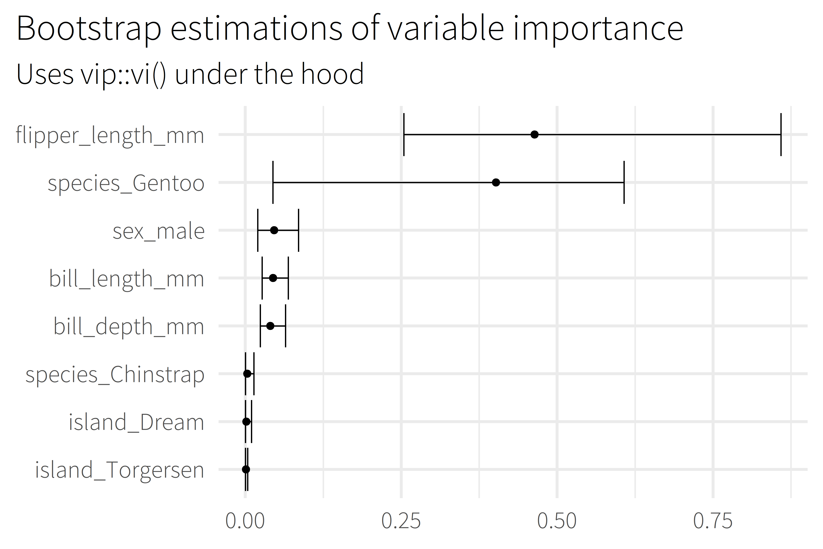
Notes:
Talk about features themselves – e.g., according to this model, flipper length is really important, but which island the penguin comes from isn’t.

Slide 52

give it a shot!
Specific tool, specific job
Generate prediction intervals
Use any model type
Notes:
Senior consumer experience analyst for Memorial Hermann Health System
Large hospital system in Houston
17 hospitals (11 acute-care)
Hundreds of clinics
Around 30,000 employees
Small but mighty team of 4 – thankful that they’re holding down the fort
Work with patient satisfaction surveys

Slide 53
thank you!
Notes:
Senior consumer experience analyst for Memorial Hermann Health System
Large hospital system in Houston
17 hospitals (11 acute-care)
Hundreds of clinics
Around 30,000 employees
Small but mighty team of 4 – thankful that they’re holding down the fort
Work with patient satisfaction surveys

Slide 54
connect with me!
Social
twitter: @markjrieke
github: github.com/markjrieke
Linkedin: linkedin.com/in/mark-j-rieke-ab4b0ab4
additional resources
Packages
ngboostForecast : Probabilistic forecasting with Python’s ngboost [CRAN/github]
ggdist : Visualizations of distributions and uncertainty [CRAN/github]
spin : Functions for simulating prediction intervals [github]
ungeviz : Tools for visualizing uncertainty with ggplot2 [github]
Reading
Bootstrap Methods and their Application, (Davison and Hinkley)
Improvements on Cross Validation – the .632+ Bootstrap Method, (Efron and Tibshirani)
Tidy Modeling with R (Kuhn and Silge)
Applied Predictive Modeling (Kuhn and Johnson)

Slide 55
Backup

